Slide 1
iUML-B and industrial collaborations
Dr. Colin Snook
Notes:
Exploring -> conquering (Jonathan)
Good level of interest from industry
Not there yet -> tool industrial strength TRL

Slide 2
Outline of talk
Co-authors and publications
will appear here
LOGO Of
Partner
or project appear here
Quick Overview of iUML-B
Recent Industrial collaborations involving iUML-B
Airbus
Thales
AWE
Sandia
Future Directions

Slide 3
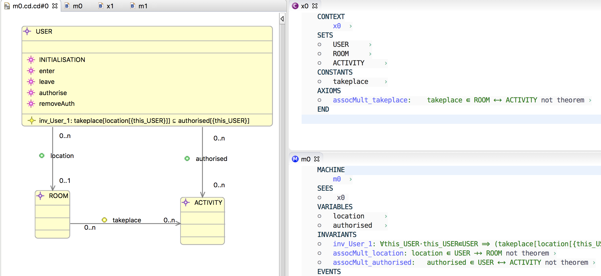
Overview of iUML-B Class Diagrams

Slide 4
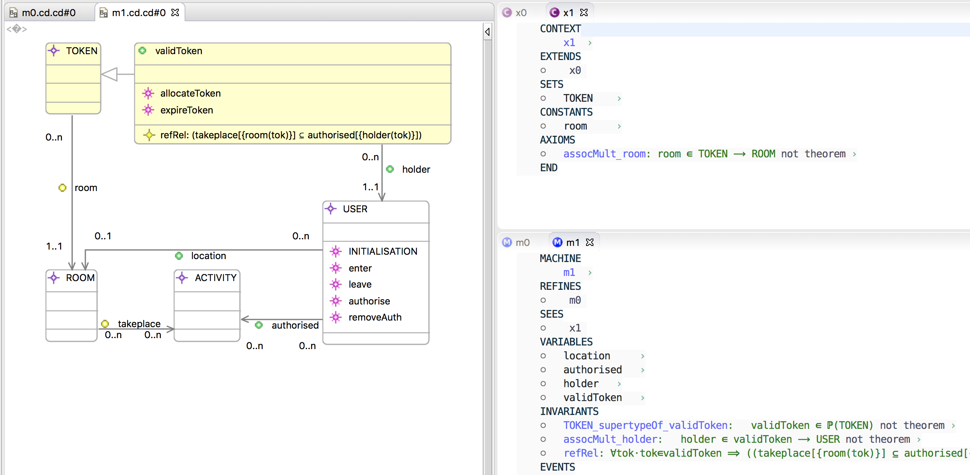
Overview of iUML-B Class Diagrams
Notes:
Superposition – need refined Class to add things to it.
Also data refinement by replacing class/association

Slide 5
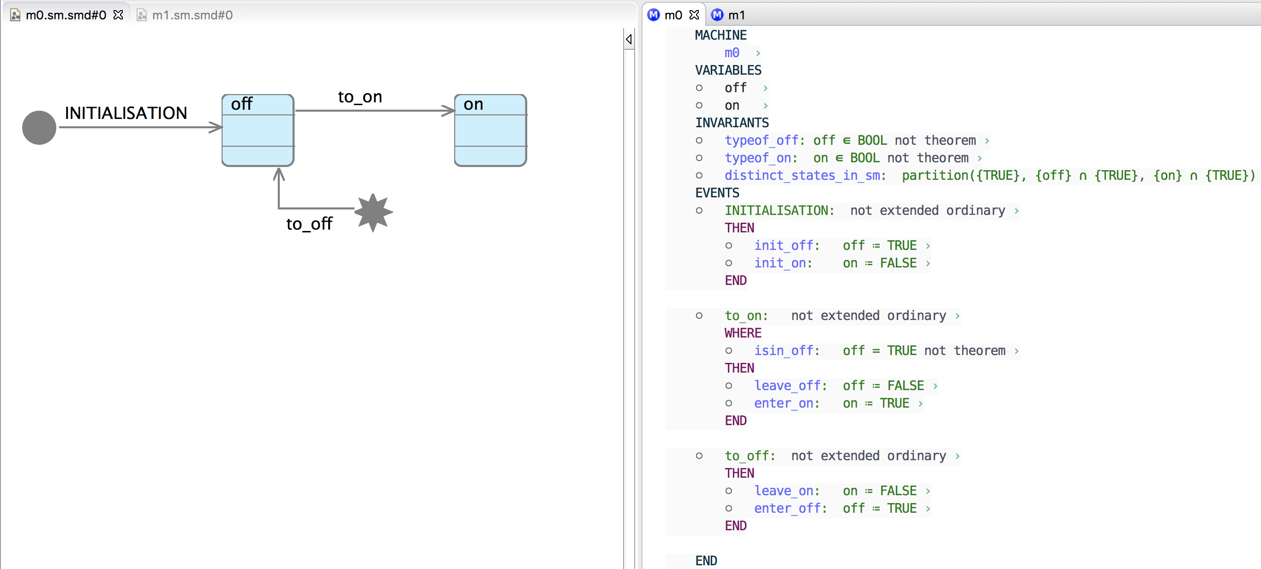
Overview of iUML-B State-machines

Slide 6
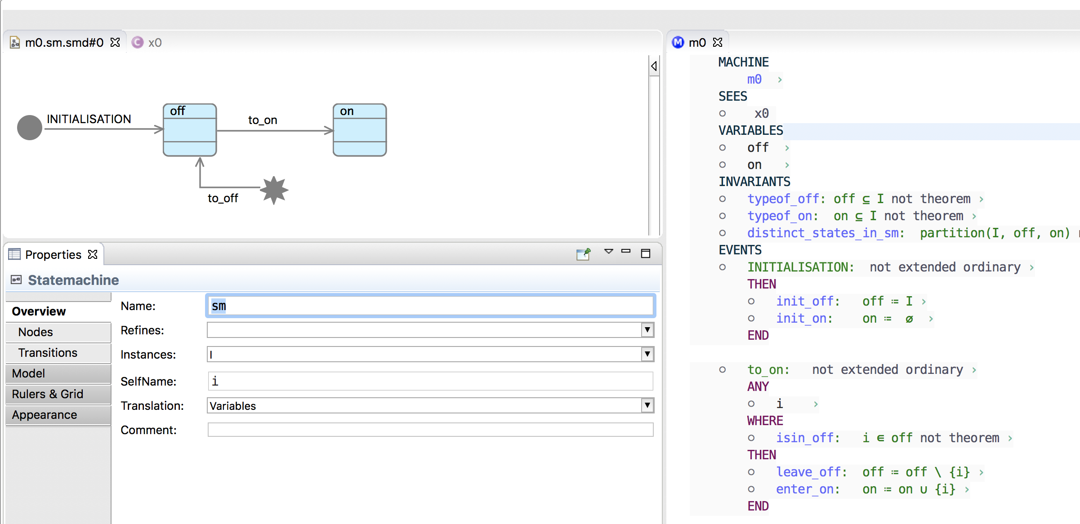
Overview of iUML-B State-machines
Translation also supports lifting state-machines to Class instances

Slide 7
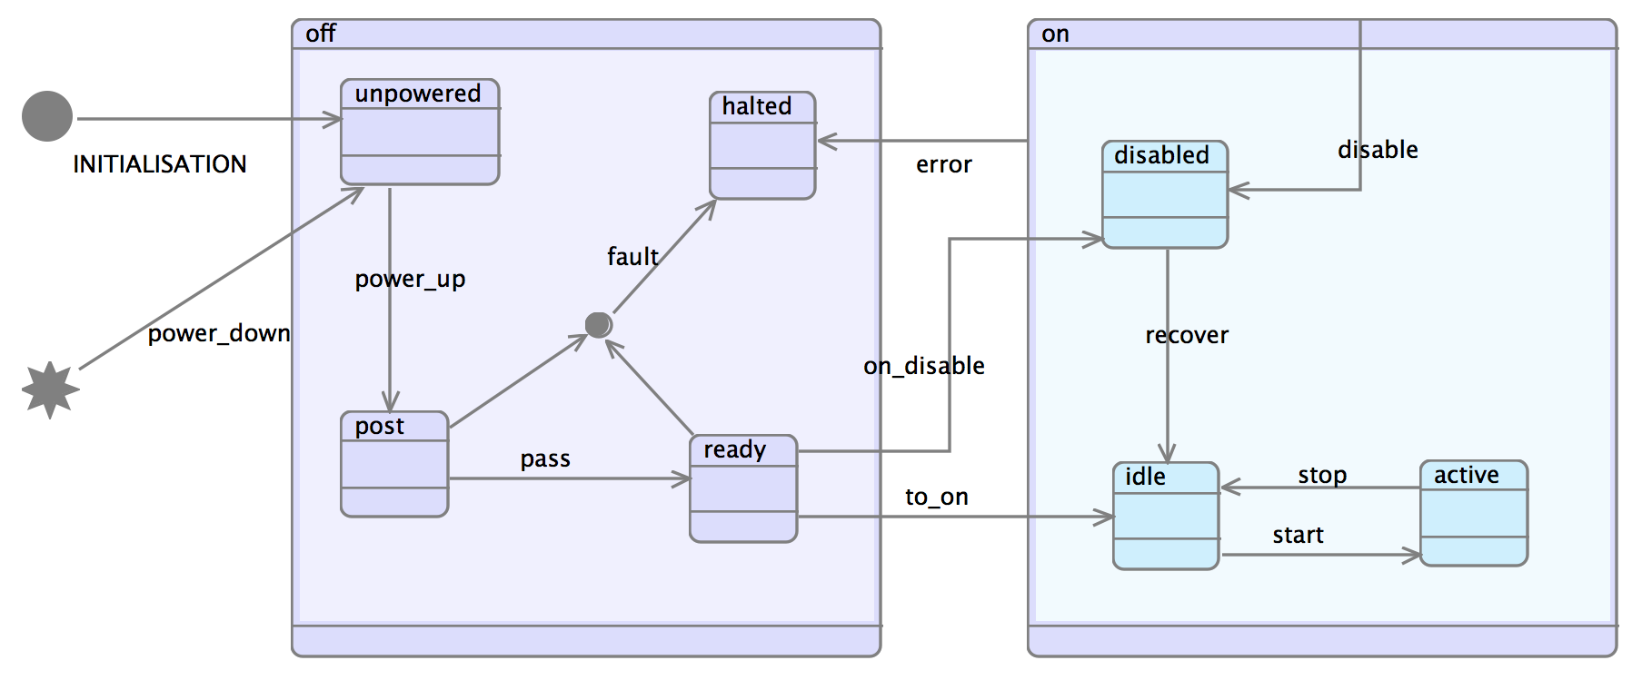
Overview of iUML-B State-machines

Slide 8
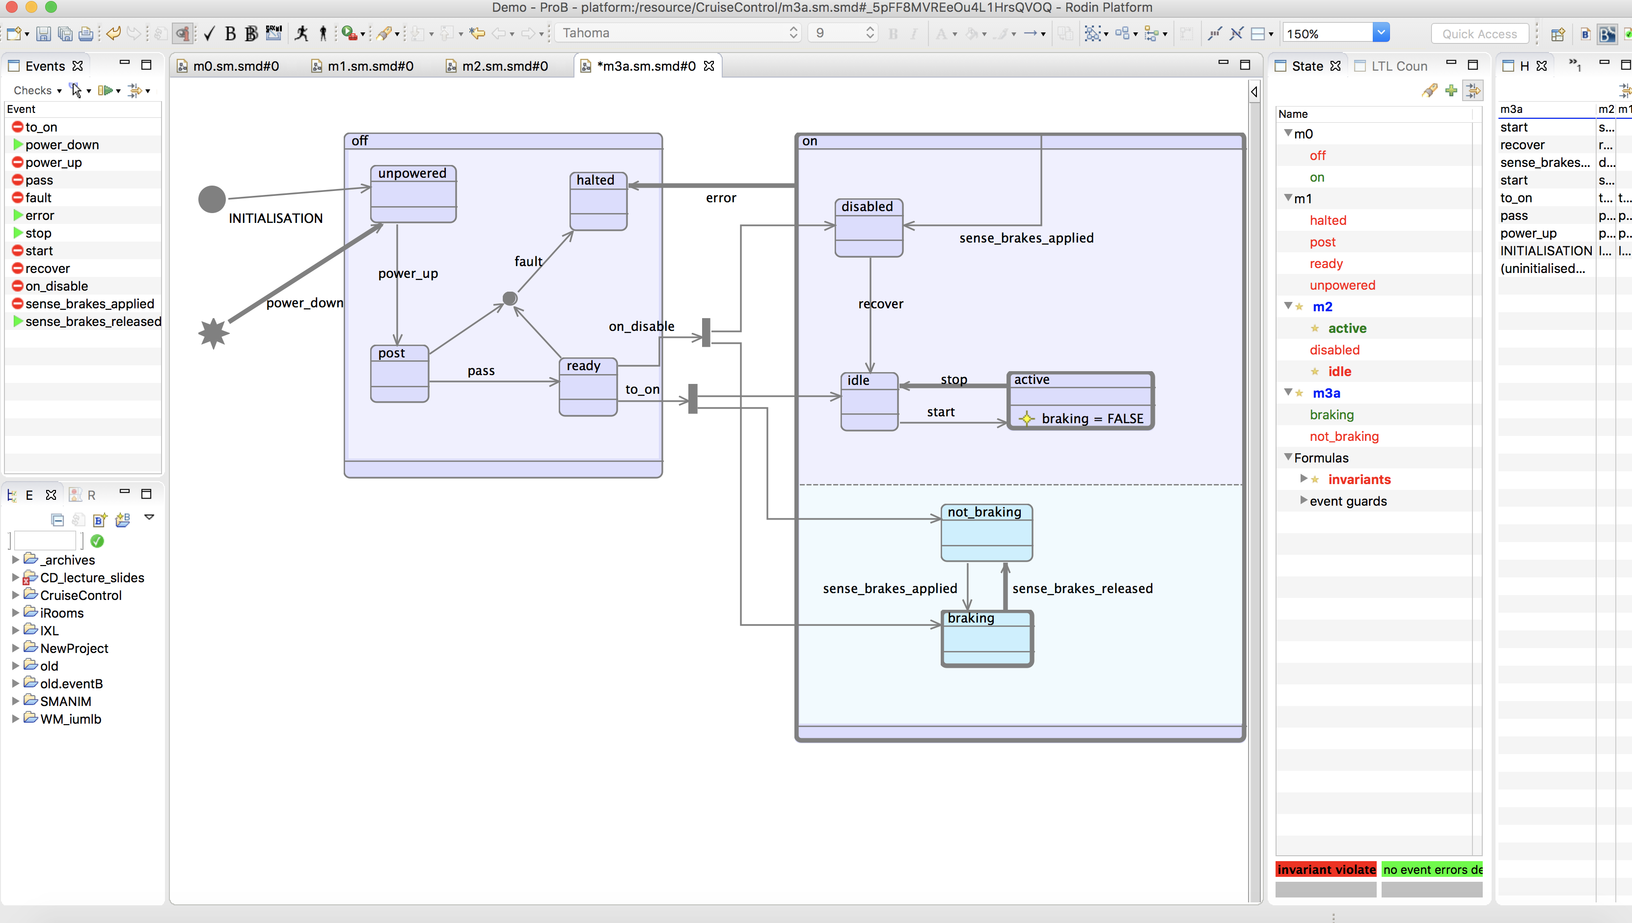
State-machine animation

Slide 9
Outline of talk
Quick Overview of iUML-B
Recent Industrial collaborations involving iUML-B
Airbus Enable-S3
Thales Enable-S3
AWE
Sandia
Future Directions

Slide 10
Enable-S3 - Horizon 2020 project
Objective: establish cost-efficient cross-domain virtual and semi-virtual V&V platforms and methods for ACPS

Slide 11
Outline of talk
Quick Overview of iUML-B
Recent Industrial collaborations involving iUML-B
Airbus Enable-S3
Thales Enable-S3
AWE
Sandia
Future Directions

Slide 12

Analysing Security protocols in iUML-B
with Thai Son Hoang and Michael Butler,
NASA Formal Methods Symposium 2017
https://link.springer.com/chapter/10.1007/978-3-319-57288-8_6
With Airbus (Munich)
Security protocols for LAN communication in aircraft
Modelled in iUML-B
An un-proven PO may be a security flaw
Use ProB Model checker to analyse the problem

Slide 13
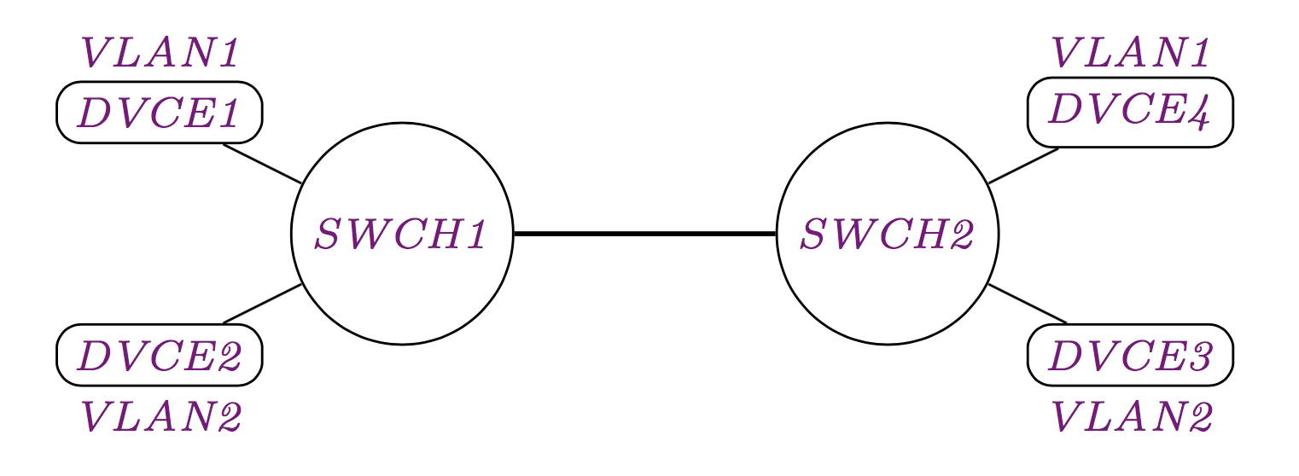
Example system: Virtual LANs
VLAN1
1
trunk
1
2
2
VLAN2
Security property:
A packet must only be seen by nodes in the same VLAN as the device that made it

Slide 14
VLAN
DVCE2 creates a packet p
1
1
2
2
p

Slide 15
VLAN
Tags it for VLAN2
1
1
2
2
2
p

Slide 16
VLAN
Sends it to SWCH1
1
1
2
2
2
p

Slide 17
VLAN
SWCH1 sends it to SWCH2
1
1
2
2
2
p

Slide 18
VLAN
SWCH2 removes the tag
1
1
2
2
p

Slide 19
VLAN
Sends it via its VLAN2 port to DVCE3
1
1
2
2
p

Slide 20
Native VLAN
DVCE1 creates a packet p
p
1
1
2
2

Slide 21
Native VLAN
Tags it for VLAN1
1
p
1
1
2
2

Slide 22
Native VLAN
Sends it to SWCH1
1
p
1
1
2
2

Slide 23
Native VLAN
SWCH1 removes the unnecessary tag
p
1
1
2
2

Slide 24
Native VLAN
Sends it to SWCH2
p
1
1
2
2

Slide 25
Native VLAN
SWCH2 sends it via its Native VLAN port to DVCE4
p
1
1
2
2

Slide 26
Approach
Build an abstract model of the security property
iUML-B Class diagrams show entity relationships
We express the Security property as an invariant over entities

Slide 27
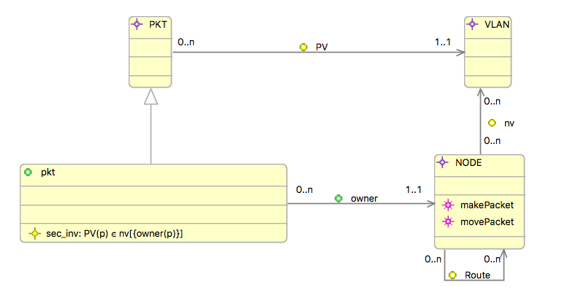
Abstract model of security property
At this level we rely on conceptual properties
The VLAN this packet is Intended for
The VLANs this node is allowed to see
Guard:
PV(p) ∈ nv[{n}]
(n is the new owner of p)
The VLAN that p is intended for must be one that the new owner of p is allowed to see.
The security property:
PV(p) ∈ nv[{owner(p)}]
The VLAN that p is intended for must be one that the owner of p is allowed to see.

Slide 28
Approach
Build an abstract model of the security property
iUML-B Class diagrams show entity relationships
We express the Security property as an invariant over entities
Refine* to introduce the design that achieves the security
iUML-B State-machines show the behaviour of the design
Validate by animation

Slide 29
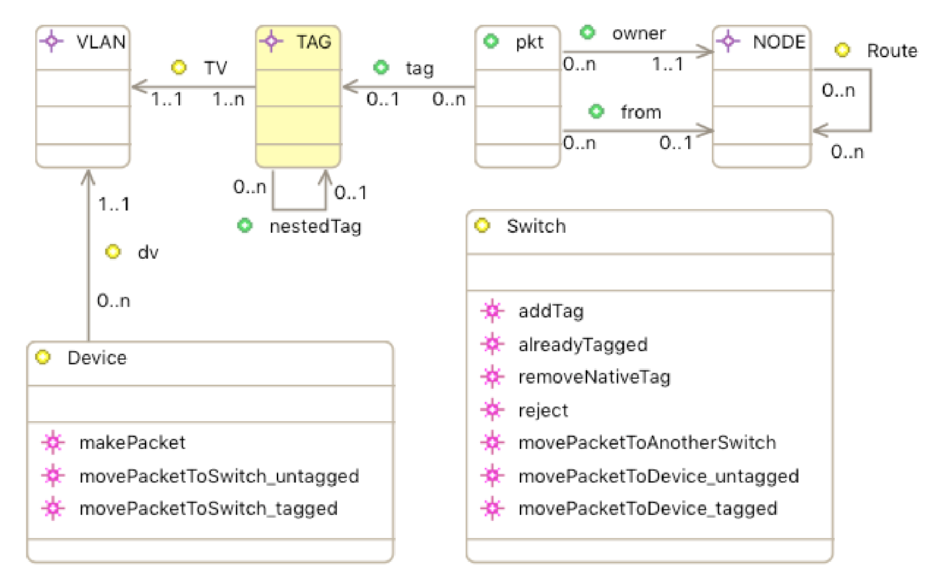
Refined model of security design
Conceptual property is replaced with tags
dv
refines
nv
Guard:
p ∉ dom(tag) ∧
dv(n)=NativeVLAN
Guard:
p ∈ dom(tag) ∧
dv(n) = TV(tag(p))

Slide 30
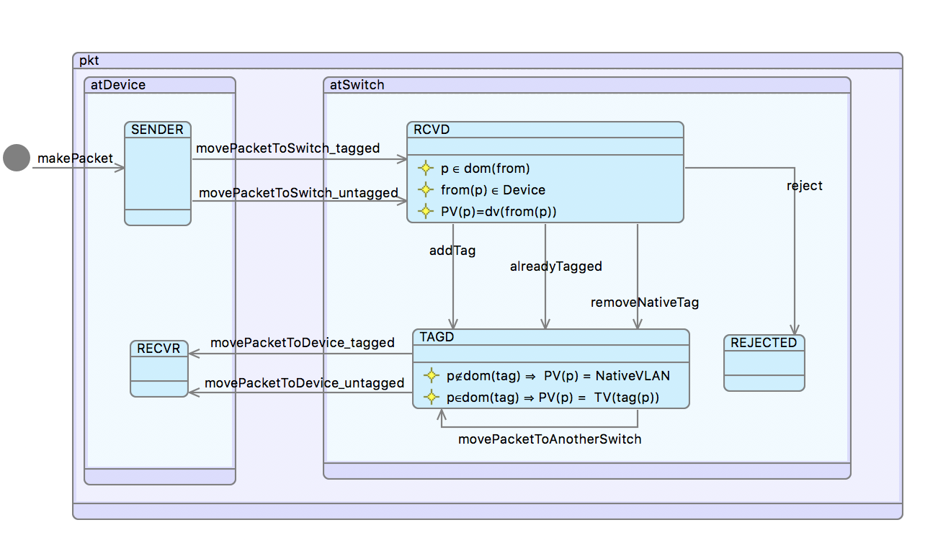
Second Refinement: Tagging
Gluing invariants relate conceptual properties to concrete design –
i.e. Gluing invariants are Design assumptions

Slide 31
Proof
One proof cannot be proven automatically..
The prover cannot prove that removeNativeTag establishes the design assumption:
p∈dom(tag) ⇒ TV(tag(p)) = PV(p)
Is it a real problem?
It could be that the prover lacked sufficient power.
We use the model checker to find a counter-example

Slide 32
Counter-example
2
p
1
1
2
2

Slide 33
Counter-example
1
2
p
1
1
2
2

Slide 34
Counter-example
1
2
p
1
1
2
2

Slide 35
Counter-example
DESIGN ASSUMPTION VIOLATED
Packet p from DVCE1 of VLAN1 is tagged for VLAN2
p ∈ dom(tag) ⇒ TV (tag(p)) = PV (p)
2
p
1
1
2
2
IS IT A REAL SECURITY BREACH?
The design assumption could be too strong

Slide 36
Counter-example
2
p
1
1
2
2

Slide 37
Counter-example
p
1
1
2
2

Slide 38
Counter-example
SECURITY BREACHED
DVCE3 of VLAN2 receives packet p from a device of VLAN1
PV(p) ∈ nv[{owner(p)}]
1
1
2
2
p

Slide 39
Summary of Approach
If the design assumption (gluing invariant) is not proven
Can model checker find a trace that violates the design assumption?
No: a manual proof may be possible
Can model checker find a trace that violates the security?
No: design assumption may be too strong
Yes: there is a security flaw.
The trace illustrates the flaw –>
Examine the PO
Invariant: the property that is violated
Event: the step of the process that breaks it
Goal: the action that breaks it
Attack
Design flaw
Security Breach

Slide 40
Outline of talk
Quick Overview of iUML-B
Recent Industrial collaborations involving iUML-B
Airbus Enable-S3
Thales Enable-S3
AWE
Sandia
Future Directions

Slide 41

Railway Control Systems in iUML-B
with Michael Butler, Dana Dghaym, Tomas Fischer, Son Hoang, Klaus Reichl, Peter Tummeltshammer
Formal modelling techniques for efficient development of railway control products , Submitted RSSRail 2017
A Railway control system is a cyber-physical system
Many devices(entities) with relationships
Entities have local behaviour
Overall behaviour requires a system level process
i.e. A process based on interactions between devices

Slide 42
Railway Control Systems in iUML-B
with Michael Butler, Dana Dghaym, Tomas Fischer, Son Hoang, Klaus Reichl, Peter Tummeltshammer
Formal modelling techniques for efficient development of railway control products , Submitted RSSRail 2017
iUML-B Class diagrams show the entity-relationships
iUML-B State-machines show the local (state-based) behaviour
But the overall process is not clear in iUML-B
Use ’Event Refinement Structure’ Diagrams to supplement iUML-B
ERS diagrams were initially developed by
Asieh Salehi and Michael Butler and extended by Dana Dghaym

Slide 43
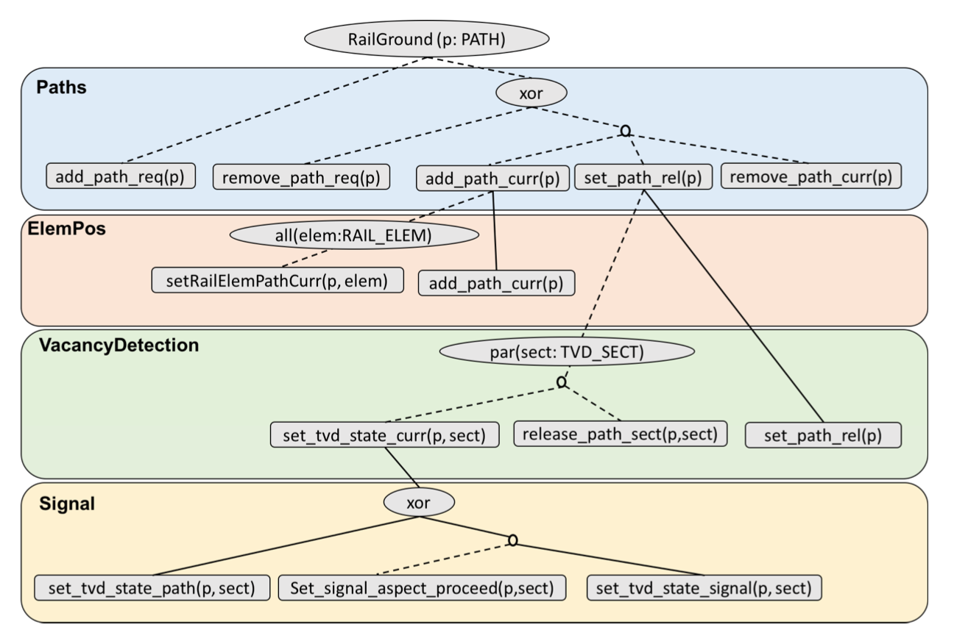
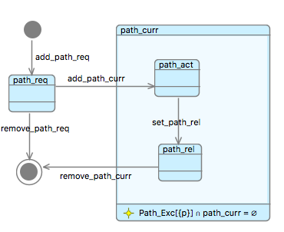
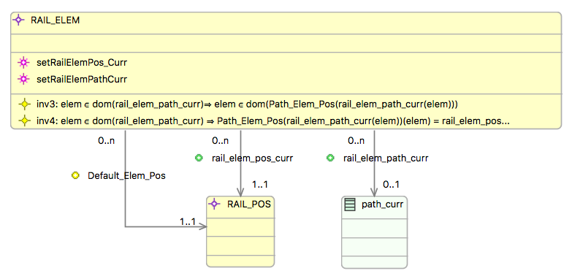
with Michael Butler, Dana Dghaym, Tomas Fischer, Son Hoang, Klaus Reichl, Peter Tummeltshammer
Formal modelling techniques for efficient development of railway control products , Submitted RSSRail 2017
Paths
ERS diagrams were initially developed by
Asieh Salehi and Michael Butler and extended by Dana Dghaym

Slide 44
Mathematical extensions in iUML-B
With Son Hoang, Dana Dghaym and Michael Butler
Class-diagrams for Abstract Data Types
ICTAC 2017
New operators can be added to the Event-B notation using
‘Theories’ (plug-in for Rodin)
Operators correspond to entity associations,
We would like to visualise these extensions using Class Diagrams
Proposal (no tool support yet)
The theory defines a new diagram node to represent the operator
The node can be used on Class diagrams when the theory is in use

Slide 45
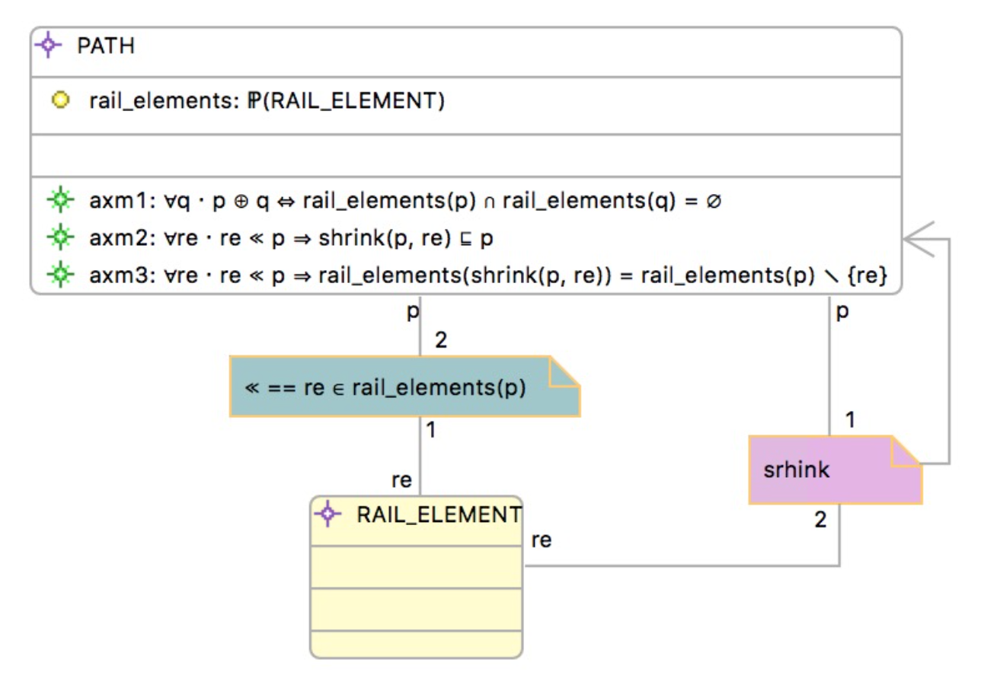
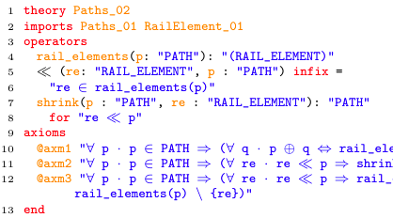
Adding New Operators
With Son Hoang, Dana Dghaym and Michael Butler
Class-diagrams for Abstract Data Types
ICTAC 2017

Slide 46
Outline of talk
Quick Overview of iUML-B
Recent Industrial collaborations involving iUML-B
Airbus Enable-S3
Thales Enable-S3
AWE
Sandia
Future Directions

Slide 47

CODA
With Michael Butler, John Colley, Andrew Edmunds, Neil Evans, Neil Grant and Helen Marshall, (2013)
Modelling and Refinement in CODA At Refine.
Hierarchical Components
Connectors – timed buffers
Component Operations
Port Wake respond to a value arriving on a port
Self Wake respond at a future point in time
Synchronised state-machines
VHDL generation
Developed for AWE Ltd
But now open source
Same infrastructure as iUML-B

Slide 48
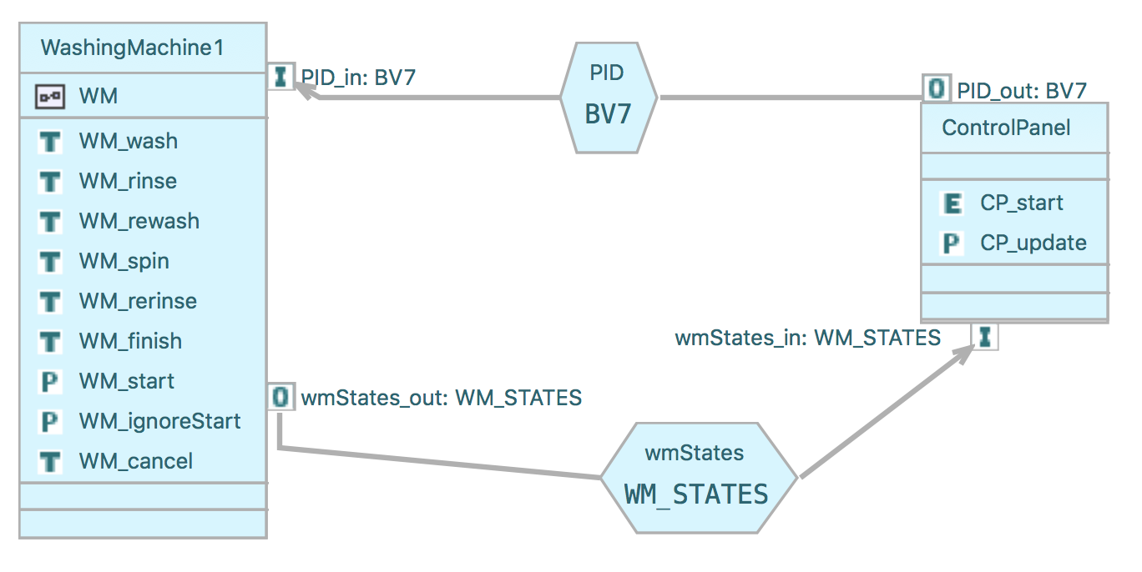
CODA
With Michael Butler, John Colley, Andrew Edmunds, Neil Evans, Neil Grant and Helen Marshall, (2013)
Modelling and Refinement in CODA At Refine.

Slide 49
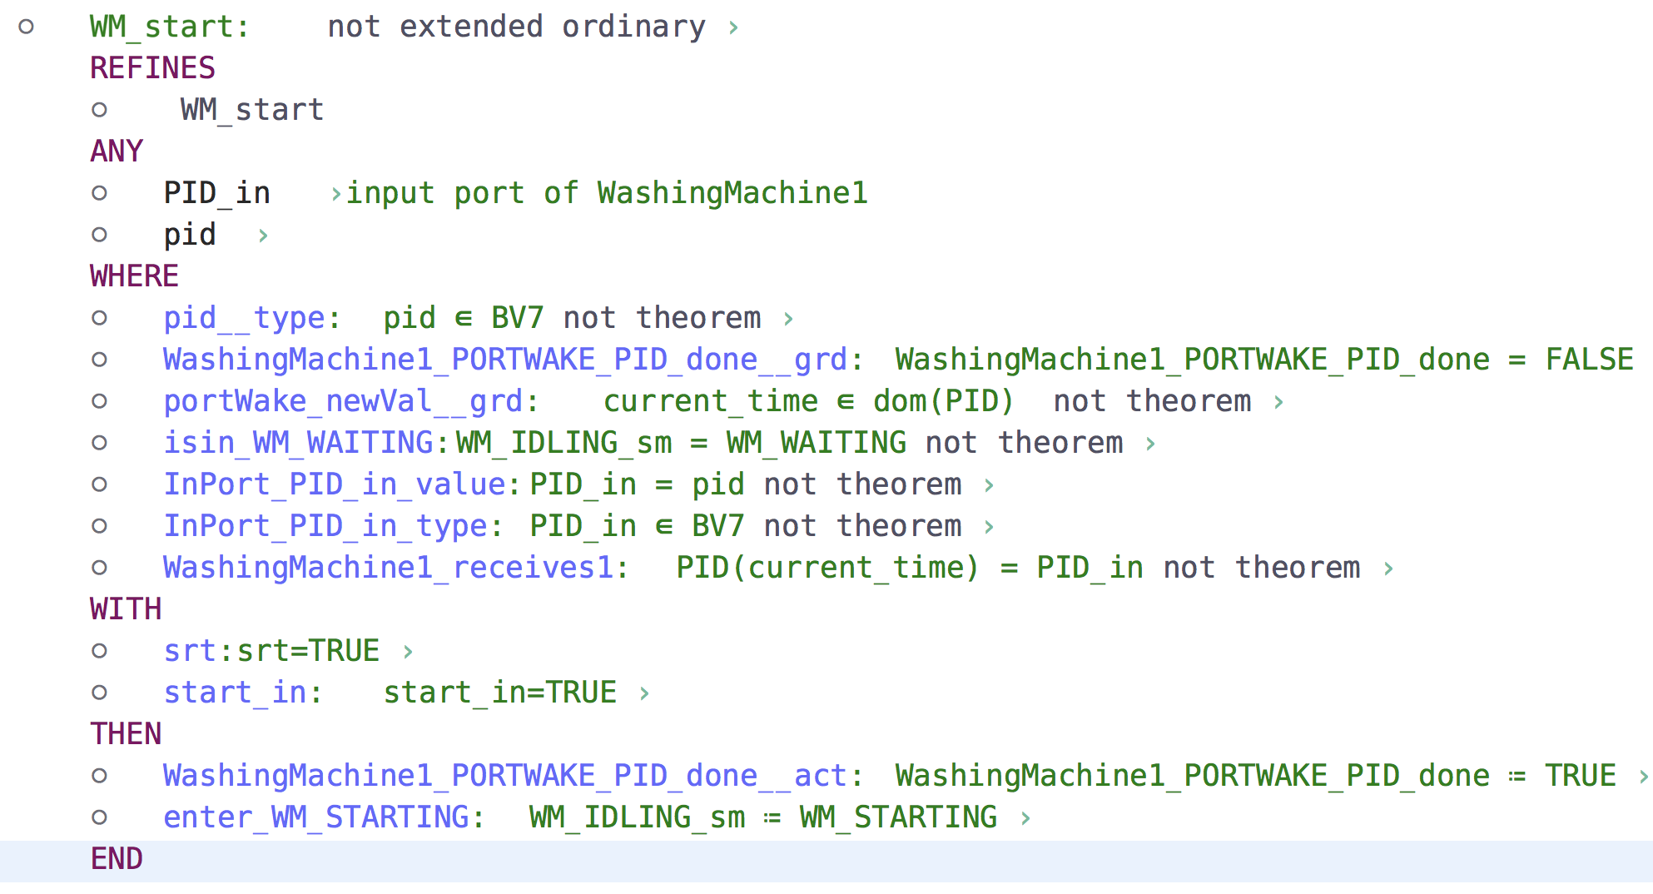
CODA
With Michael Butler, John Colley, Andrew Edmunds, Neil Evans, Neil Grant and Helen Marshall, (2013)
Modelling and Refinement in CODA At Refine.
When a value arrives on a port,
The clock cannot progress until a PortWake operation has handled it

Slide 50
CODA - decomposition
With Michael Butler, John Colley, Andrew Edmunds, Neil Evans, Neil Grant and Helen Marshall, (2013)
Modelling and Refinement in CODA At Refine.
Using ‘Shared event’
decomposition
(Re-)
composition
machine

Slide 51
Component modelling
With Sophia Meacham
CODA is designed as a hardware modelling tool
Timed channels
We would like something similar but more general for iUML-B
Looking at adding SysML style diagrams to iUML-B
Block diagrams, internal block diagrams
Work in progress

Slide 52
Outline of talk
Quick Overview of iUML-B
Recent Industrial collaborations involving iUML-B
Airbus Enable-S3
Thales Enable-S3
AWE
Sandia
Future Directions

Slide 53

Run 2 completion + refinement
with Karla Morris, (2016),
Reconciling SCXML Statechart Representations and Event-B Lower Level Semantics, HCCV
Sandia want run-to-completion state-chart semantics
E.g. Harel, UML, SCXML
… but with refinement
Initial attempt
Extended SCXML meta-model
New attribute gives element refinement level
Translate into iUML-B State-machine
Many refinements from one SCXML statechart
.. But we didn’t capture the run to completion semantics

Slide 54
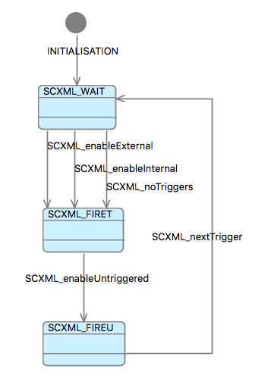
Run 2 completion + refinement
with Karla Morris, (2016),
Reconciling SCXML Statechart Representations and Event-B Lower Level Semantics, HCCV
Second attempt
Model the R2C simulation ‘engine’
SCXML_nextTrigger must not fire until all enabled user transitions have completed.
Problem:
If we strengthen the user guards,
Weaken the completion guard
Users triggered transitions
Users untriggered transitions

Slide 55
Outline of talk
Quick Overview of iUML-B
Recent Industrial collaborations involving iUML-B
Airbus Enable-S3
Thales Enable-S3
AWE
Sandia
Future Directions

Slide 56
Future Directions
Class Diagram to support new operators (‘Theories’)
Integration of ERS into iUML-B
Component diagrams in iUML-B (like SysML)
(de)composition as in CODA
Other things driven by EnableS3
HUTN – text persistence for iUML-B
DSLs for configuring product-line to a specific customer

Slide 57
Thank you
Questions?

